Slide 1

Presentation Topic : Linux
Course Title : Operating System
Course Code : ICT-2201
Presented By :
Limon Hasan
ID: IT-24041
Department of Information and Communication Technology ,
MBSTU
Supervised By :
Dr. Nazrul Islam
Associate Professor,
Department of Information and Communication Technology ,
MBSTU

Slide 2

What is Linux?
Open-source Operating System
Based on Unix
Free and customizable

Slide 3
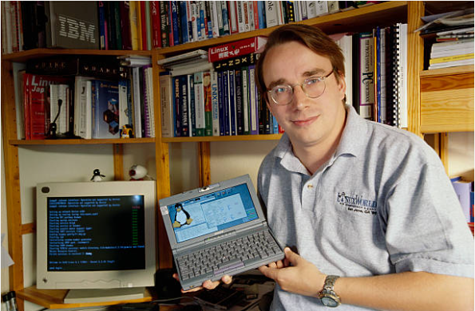
History of Linux:
Created by Linus Torvalds
Year: 1991
Started as a small project

Slide 4
Features of Linux:
Multi-user
High security
Open-source
Multi-tasking
Stable system

Slide 5
CentOS
Ubuntu
Linux Mint
Linux Distributions
Debian
Kali Linux
Fedora
Arch Linux
Red Hat

Slide 6
Basic Linux Commands :
Command | What it does
whoami | Shows user name
hostname | Shows machine name
pwd | Shows the current location
ls | List files in directory
cd | Change directory
mkdir | Create new folder
touch | Create new file

Slide 7
Basic Linux Commands :
Command | What it does
mv | Move or rename files
cp | Copy file
rm | Delete files
cat | Show file content
clear | Clear screen
cd .. | Remove directory
nano | Create file

Slide 8
Advantages :
Free to use
Secure from viruses
Lightweight and fast performance
Stable operating system
Widely used in servers

Slide 9
Uses of Linux :
Servers and web hosting
Android mobile operating system
Supercomputers
Cybersecurity tools
Software development
Embedded systems
Education and research institutions

Slide 10
Conclusion :
Linux is a powerful and flexible operating system.
It is free, secure, and stable .
Widely used in servers, development, and devices .
A great choice for both beginners and professionals .

Slide 11
Thank you

